Slide 1
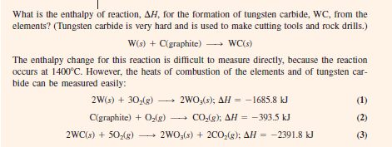

Hess’s Law Problem
Problem 1
Solution of problem 1

Slide 2
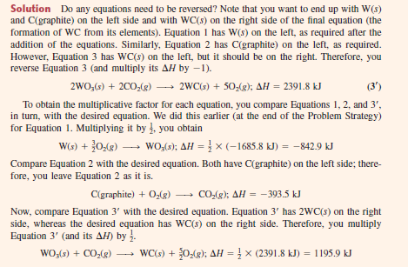


Slide 3


Slide 4


Problem 2
Solution of problem 2

Slide 5
